Slide 1

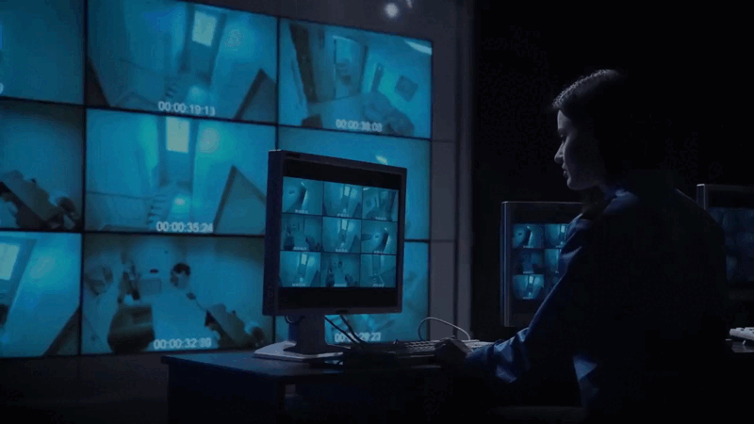
VioDetect AI
Smart Surveillance
& Life Detection System

Slide 2
VioDetect AI
Problem Statement
System Overview
table of content
Models
System Architecture
Challenges & Limitations
Business Potential
Future Work

Slide 3

VioDetect AI
Problem Statement
Public Safety Concerns
Manual Limitations
Real-time Response Need
smart documentation
Violence and safety threats are growing in public environments.
Human surveillance is often unreliable, slow, and resource-intensive.
Immediate, automated detection is vital for proactive intervention.
evidence is generated after incidents,
Traditional systems only store raw video footage.

Slide 4



VioDetect AI
Project Objectives
mission
Detect violent behavior in real-time using deep learning models.
Track and identify individuals involved in suspicious activities.
Integrate fire and emergency detection into video analysis.
Build an interactive admin dashboard for live alerts and detailed reports.
Design a scalable backend infrastructure for multi-camera, real-time processing.
vision
To create an intelligent and scalable surveillance system capable of detecting violence and life-threatening events in real-time, enhancing public safety and emergency responsiveness.
highest standards of quality

Slide 5

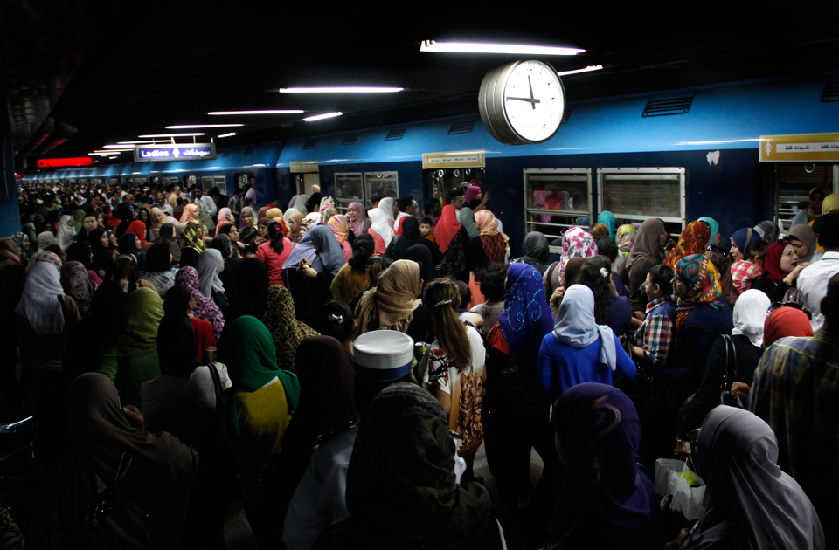
VioDetect AI
Business
Potential

Slide 6

VioDetect AI
Competitive Advantage
Feature | Traditional CCTV | Smart Surveillance
Real-time Alerts | ❌ (Passive Recording) | ✅ (Instant Notifications)
Proactive Detection | ❌ (Requires human to spot) | ✅ (AI detects before escalation)
Person Tracking (across cameras) | ❌ (Manual, time-consuming) | ✅ (Automated with Re-ID)
Event Search | ❌ (Hours of rewinding) | ✅ (Seconds via smart filters)
AI Model | None | MobileNetV2 + BiLSTM (Lightweight & Accurate)
Scalability | Limited by human operators | Highly Scalable (Cloud-based)

Slide 7
VioDetect AI
Target Audience
University Dean
Police Officer
Mall Security Manager

Slide 8


VioDetect AI
System Overview
Division Overview
AI model for violence classification
fire detection
person tracking .
Flask API for model serving
Laravel backend
React.js frontend

Slide 9
VioDetect AI
Detection Model
Division Overview
Data &
Pre-processing
Model Architecture
MobileNetV2
Model Training & Compilation
Deployment & Real-Time Inference

Slide 10
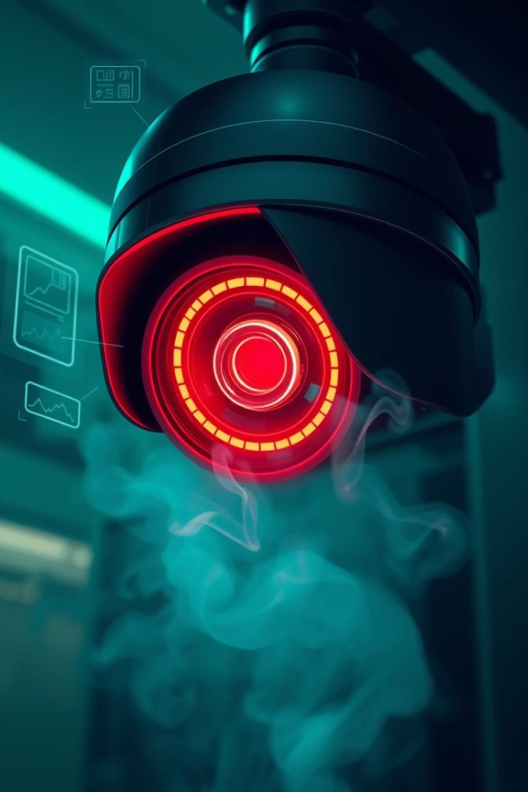
VioDetect AI
1
Data & Pre-processing
01
Real-world videos from public ,Short clips (3–5 sec)
Balanced labels in– violent & non-violent scenes
02
Frame Extraction and Sampling: extract a fixed sequence of frames (e.g., 12 frames)
03
Image Standardization: resize them to a standard 224x224 format
04
Dataset Creation and Splitting

Slide 11
VioDetect AI
02
Model Architecture
01
Frame-by-Frame Feature Extraction
A TimeDistributed layer applies our feature extractor (MobileNetV2).
02
Sequential Feature Analysis
Bidirectional LSTM, understanding motion and context over time.
03
Advanced Contextual Understanding
By processing the Bi-LSTM model, reducing confusion between real violence and similar high-energy movements.
04
Final Classification: "Violence" or "Non-Violence".

Slide 12
VioDetect AI
03
MobileNetV2
01
A Lightweight & Efficient CNN
02
Enabling Real-Time Performance
03
Powerful Transfer Learning
04
Optimal Balance of Speed and Accuracy

Slide 13
VioDetect AI
04
Model Training & Compilation
01
Loss Function: Binary Crossentropy "Violence" vs. "Non-Violence" task.
02
Optimizer: Adam
to minimize errors and improve accuracy.
03
Key Metric: Accuracy
We monitor accuracy during training to track how well the model is learning.
04
Dataset Split: 80/20
We use 80% training & 20% for final, unbiased testing.

Slide 14
VioDetect AI
05
Deployment & Real-Time Inference
01
Serving with Flask API
The trained Keras model is wrapped in a lightweight and efficient Flask web server.
02
The /predict Endpoint
We created a simple API endpoint that accepts a video file for immediate analysis.
03
The Prediction Process
The API receives video, pre-processes it, and passes it to the model for inference.
04
JSON Response

Slide 15
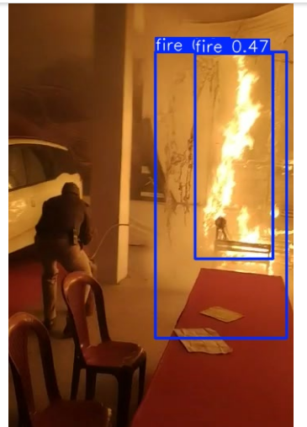
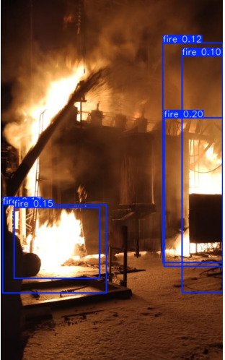
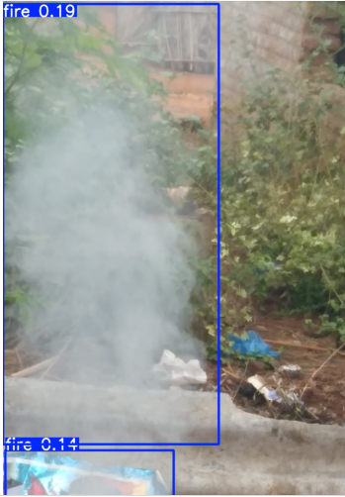
VioDetect AI
Real-Time Fire Detection Using YOLOv5"

Slide 16

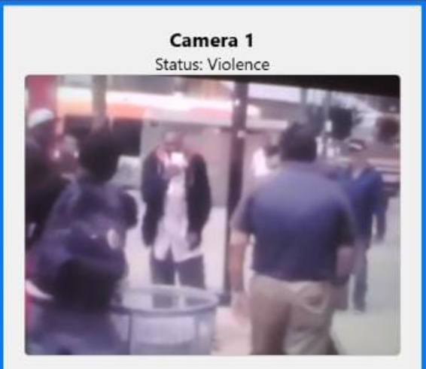
VioDetect AI
Evaluation & Testing
Result
Accuracy: 87.5%
Precision: 88%, Recall: 97.5%
Response time: ~0.5s for prediction
End-to-End latency: 7–8 seconds

Slide 17
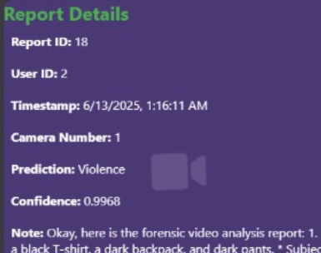
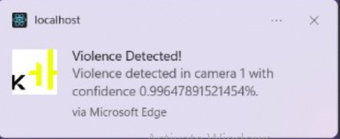
VioDetect AI
Reports
Evaluation & Testing
Notification

Slide 18










VioDetect AI
System Architecture & Framework
Data Storage & Reporting System
Video Input Layer
Events are stored in MySQL with timestamp, camera ID, video path, and confidence score.
Auto-generated reports summarize incidents by date, location, and type.
Admins can access reports .
IP cameras like Axis P1375 and Hikvision. RTMP/RTSP streams are supported. We process 1080p@30FPS video.
AI Core Modules
Dedicated pipelines for Violence Detection. Fire Detection runs concurrently. Both use CNN and YOLO models.
Monitoring Dashboard
Web-based UI (ReactJS) for live feeds. Event logs and visual confirmations are displayed. System health status is visible.
Alert & Notification
MQTT sends real-time SMS/Email alerts. Integration with siren systems. Custom API for third-party VMS.

Slide 19
VioDetect AI
SYSTEM FEATURES
Real-time Incident Management
Complete User Control
Full Camera Configuration & Assignment

Slide 20
VioDetect AI
Challenges & Limitations
Complex Scene Ambiguity
Single-
Action
Focus
Computational Cost

Slide 21
VioDetect AI
Future Enhancements &
Expansion
1. Multi-Class Action Recognition
2. Anonymous Phone-Based Tracking
3. Multi-Class Action Recognition
4.Integration with Existing Security Systems
Instead of only detecting violence, the system will classify different types of actions (e.g., fighting, theft, falling, vandalism).
Use anonymous mobile signals (Wi-Fi/Bluetooth) to track movement across areas. Combine with video tracking to build full person paths.
Instead of only detecting violence, the system will classify different types of actions (e.g., fighting, theft, falling, vandalism).
Allow the system to connect with existing CCTV infrastructure. Generate automatic logs, control smart locks or alarms based on AI predictions..

Slide 22
VioDetect AI
OUR TEAM
Abdallah Ashraf
Andrew Sherif
Andrew Atef
ziena Samer
Alaa Hisham

Slide 23
VioDetect AI
thank you

